Slide 1
Module 18

Slide 2

Let’s see some interesting facts about brain

Slide 3
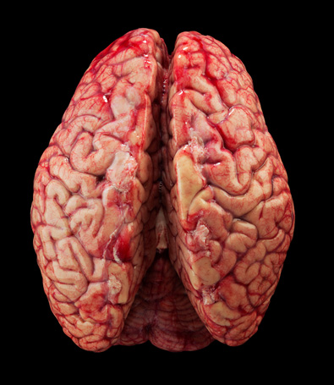
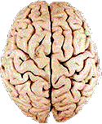
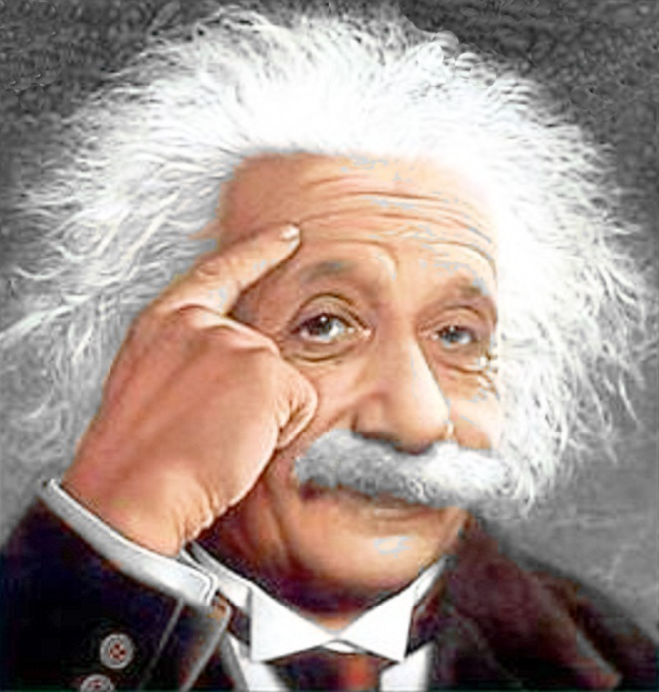
Left hemisphere of the brain has 186 million
more neurons than the right hemisphere
750 – 1000 ml of blood flows through the brain every minute
Einstein’s brain weighed
1230 gm, less than average
Wight of human brain
which is approximately
1300 to 1400 gm
Brain can stay alive for 4 – 6 minutes without
oxygen after that cells begins to die

Slide 4
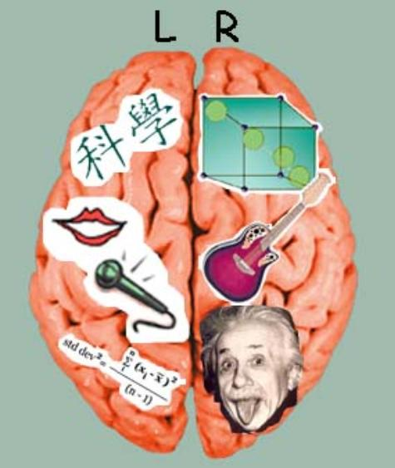
Left side of the brain controls
Right side of the brain controls
Speaking
Artistic abilities
Writting
And Logical thought
Left side of the brain controls
Right side of the brain controls
Left part of the body
right part of the body

Slide 5

MEMORY are of three types
How does our memory work ?
SENSORY
MEMORY
SHORT TERM MEMORY
LONG TERM MEMORY
Tells us
Is what we have
What is happing around us which is called as
Lasts only for
LEARNED
&
MEMORIZED
BRIEF MEMORY
30 SECONDS

Slide 6
Thank You

